Slide 1
Eragon
Christopher Paolini

Slide 2
Eragon found a mysterious rock in the woods that is harder than diamond

Slide 3
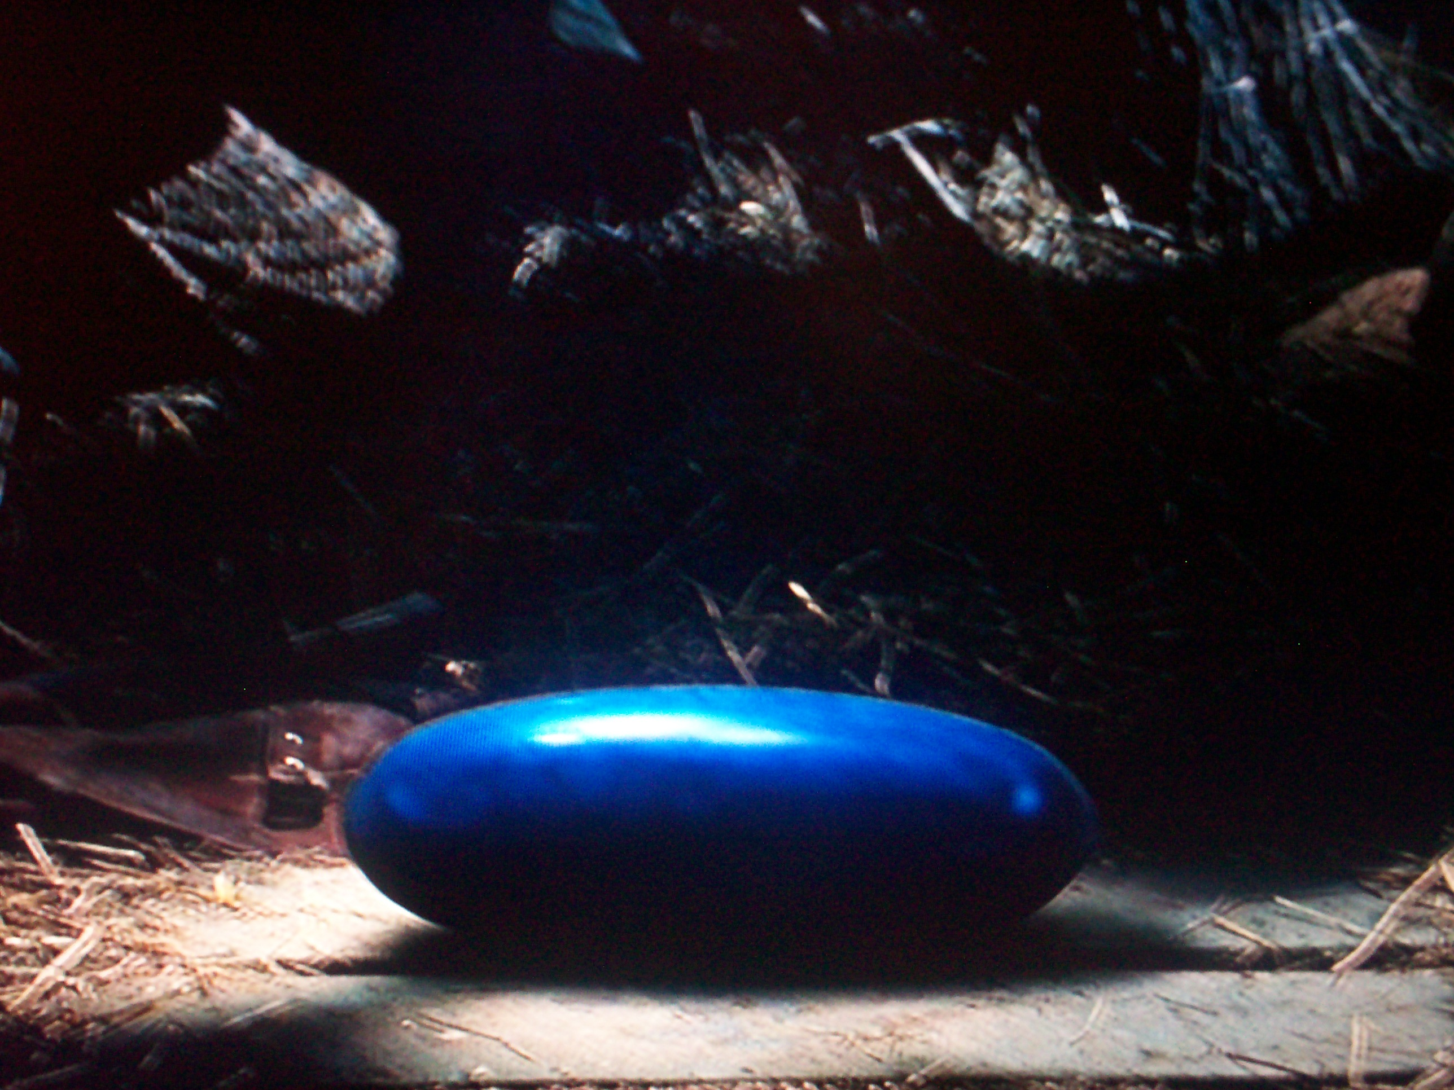

Slide 4
Then the rock hatched

Slide 5
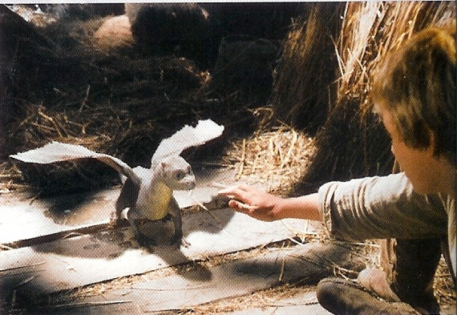

Slide 6
But Galbatorix and his inhuman Ra’zac want the dragon all for themselves

Slide 7
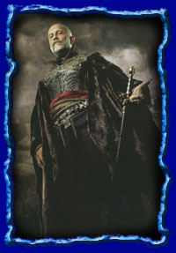

Slide 8
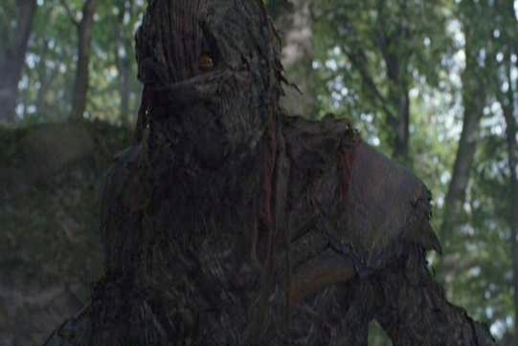

Slide 9
Who will win? Good or Evil?

Slide 10
Find out in Christopher Paolinis Eragon

Slide 11
